Slide 1
Presentation on Variables, Data Type, Bind Variables and PL SQL
Donald, Ezra, Olando and Shippy

Slide 2
Variables
One of the most important concepts in coding is a variable. A variable is a name for a piece of data that can change. An easy way to remember is that a variable can vary, or change in value.
There’s lots of information that is important to you every day that changes value. Here are some examples:
Your age
The weather
Today’s date

Slide 3
Variables CON’T
Variables are a way for your app to remember something. Just like the box, your variables will need a couple of things.
A name so that your app can find it
Some information to store

Slide 4
Variables CON’T
Variables are useful anytime you need your app to “remember” some information and when that information might change. Here are some examples:
A player’s score in a game
A person’s answer to a quiz question
Things that are in someone’s shopping cart

Slide 5
Variables CON’T
Picture a variable as a box that you can store some information inside of and put away. Before you put it away, you put a name on the box to remember what is inside of it. When you need the information you can go find the box get what if inside. You can also change what is inside the box but keep the same name on it.

Slide 6
Data types
Any object's data type can be specified by the attribute "Data Type." Every column, variable, and expression in SQL has a corresponding data type. When making your tables, you can utilize these data kinds. Based on your needs, you can select a data type for a table column.

Slide 7
Data type has two groups
Primitive
Non-Primitive
Byte
Short
Int
Long
Float
Double
Boolean
Char
String
Array
Classes

Slide 8
Bind variables
Bind parameters—also called dynamic parameters or bind variables—are an alternative way to pass data to the database. Instead of putting the values directly into the SQL statement, you just use a placeholder like ?, :name or @name and provide the actual values using a separate API call.

Slide 9
Bind variables con’t
Two reasons for using bind variables are for security and performance
1. Security - they are used to prevent SQL injection
2. Performance - Databases with an execution plan cache like SQL Server and the Oracle database can reuse an execution plan when executing the same statement multiple times.
When using bind parameters you do not write the actual values but instead insert placeholders into the SQL statement. That way the statements do not change when executing them with different values.

Slide 10
Pl sql
PL SQL stands for : Procedural Language extensions to the Structured Query Language
Some Types of Operators
Arithmetic operators
Relational operators
Comparison operators
Logical operators

Slide 11
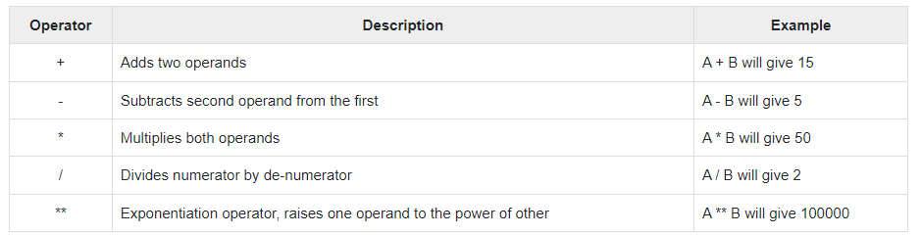
Arithmetic Operators

Slide 12
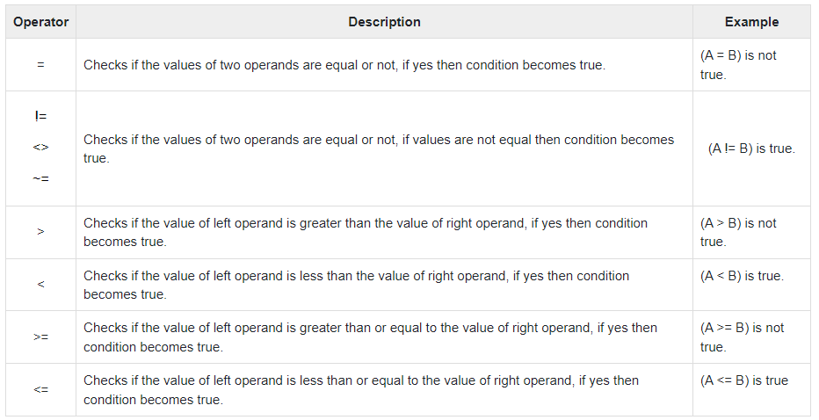
Relational Operators

Slide 13
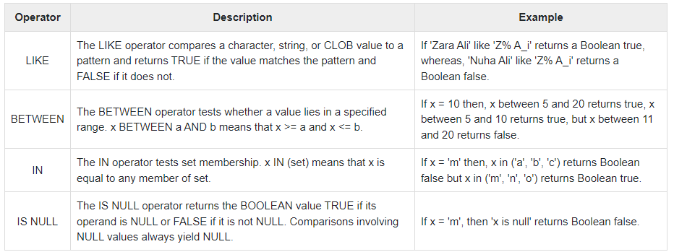
Comparison Operators

Slide 14
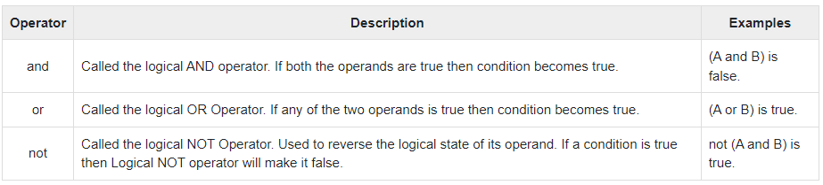
Logical Operators

Slide 15
Nested Block
To nest a block means to embed one or more PL/SQL blocks inside another PL/SQL block that provide you with a better control over program execution and exception handling.

Slide 16
EXAMPLES

Slide 17
Variables
Age = 19
Name = ‘John’
Salary = 98000.00
19 is assigned to Age.
John is assigned to Name.
98000.00 is assigned to Salary

Slide 18
Data type
Int Age = 19
String Name = ‘John’
Double Salary = 98000.00
Age is int
Name is string
Salary is double

Slide 19
BIND VARIABLES
Variable id Number
Begin
:id :=1;
End
Print id
Output – ID = 1

Slide 20
PL SQL
Arithmetic
Relational
Int num = 10
Int num2 = 5
Num + num2 = 15
Num - num2 = 5
Num * num2 = 50
Num / num2 = 2
(num = num2) is not true.
(num != num2) is true.
(num > num2) is true.
(num < num2) is not true.
(num >= num2) is true.
(num <= num2) is not true.

Slide 21
PL SQL
Comparison
If 'Zara Ali' like 'Z% A_i' returns a Boolean true, whereas, 'Nuha Ali' like 'Z% A_i' returns a Boolean false.\
If x = 10 then, x between 5 and 20 returns true, x between 5 and 10 returns true, but x between 11 and 20 returns false.
If x = 'm' then, x in ('a', 'b', 'c') returns Boolean false but x in ('m', 'n', 'o') returns Boolean true.
If x = 'm', then 'x is null' returns Boolean false.

Slide 22
PL SQL
Logical
(num and num2) is false.
(num or num2) is true.
not(num and num2) is true.

Slide 23
Nested Blocks
DECLARE v_outer_variable VARCHAR2(20):='GLOBAL VARIABLE’;
BEGIN DECLARE v_inner_variable VARCHAR2(20):='LOCAL VARIABLE’;
BEGIN DBMS_OUTPUT.PUT_LINE(v_inner_variable);
DBMS_OUTPUT.PUT_LINE(v_outer_variable);
END;
DBMS_OUTPUT.PUT_LINE(v_outer_variable); END;

